Slide 1
Incorporating Societal Context in an UG Algorithms course
@University at Buffalo
Atri Rudra

Slide 2
UB UG algorithms course overview (CSE 331)
Algorithms and Complexity
Required for all BS CS majors
We are in Buffalo, Erie county, NY

Slide 3
Imagine yourself in the first CSE 331 lecture
About 260 kids in the class with you
About 240 of them are there because they have no choice

Slide 4
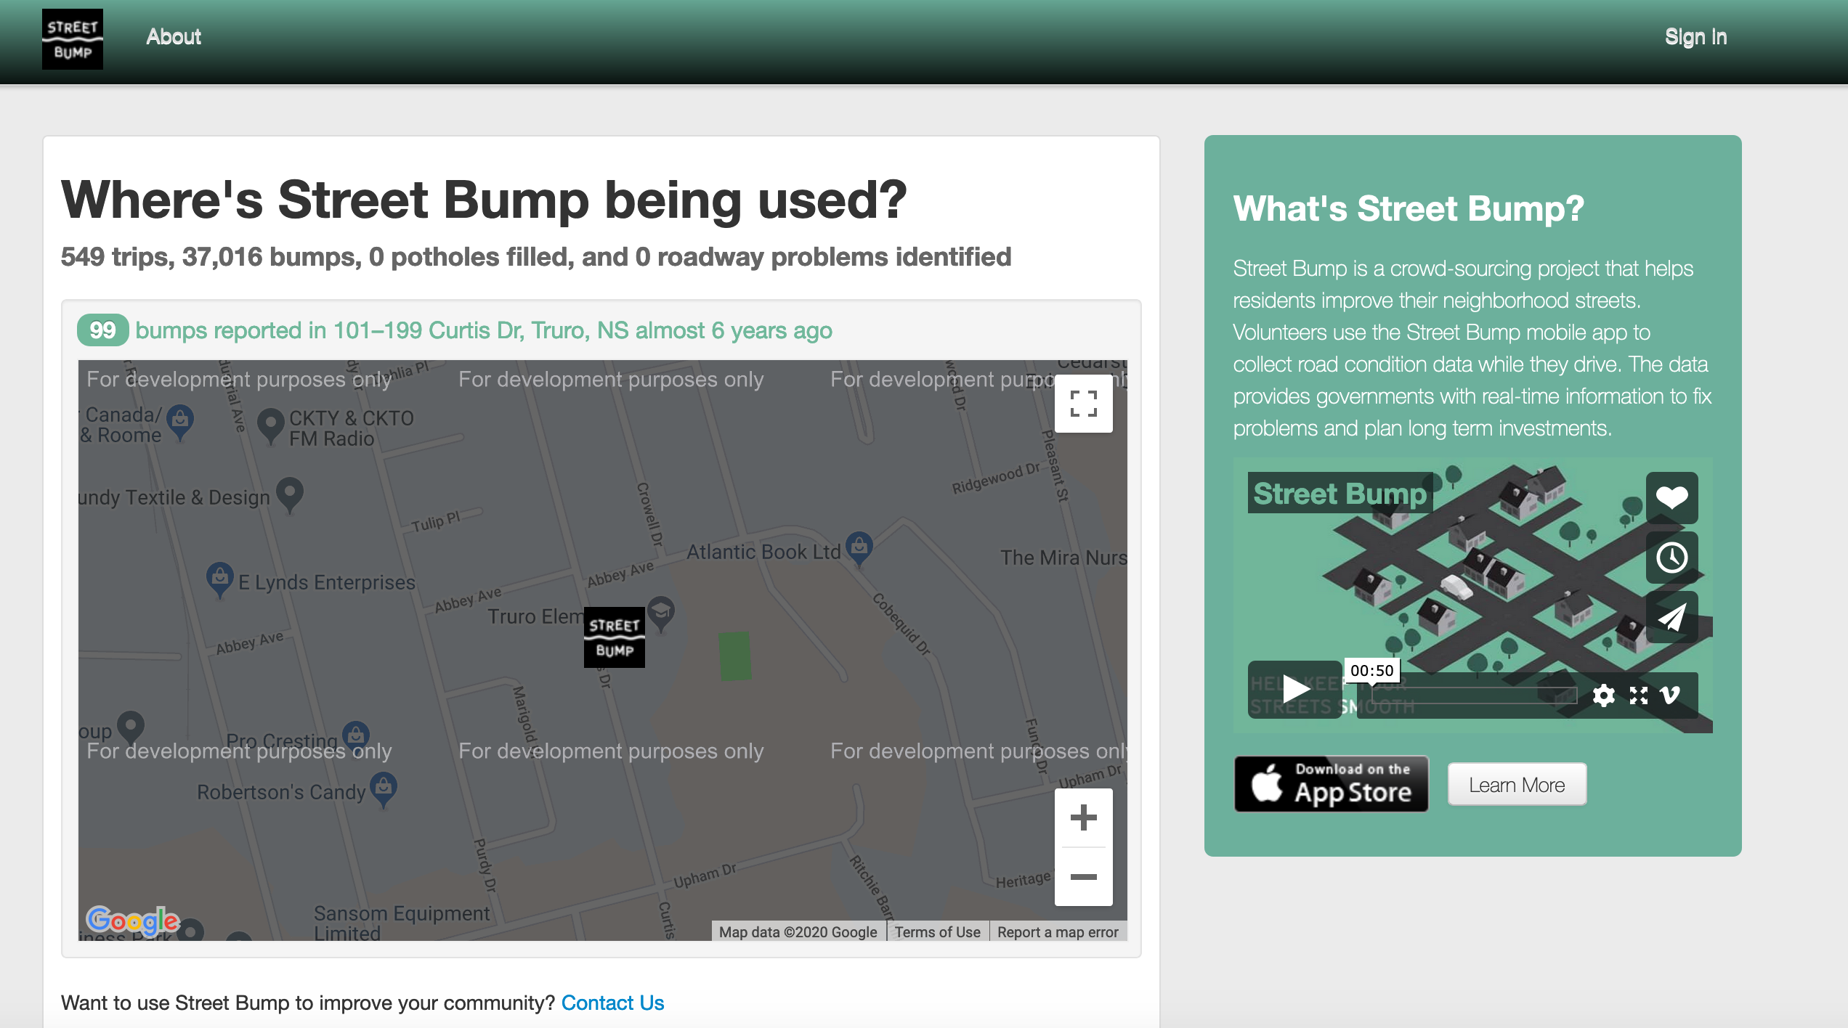
Common solution: Let’s build an app for that!
Potential issues?

Slide 5
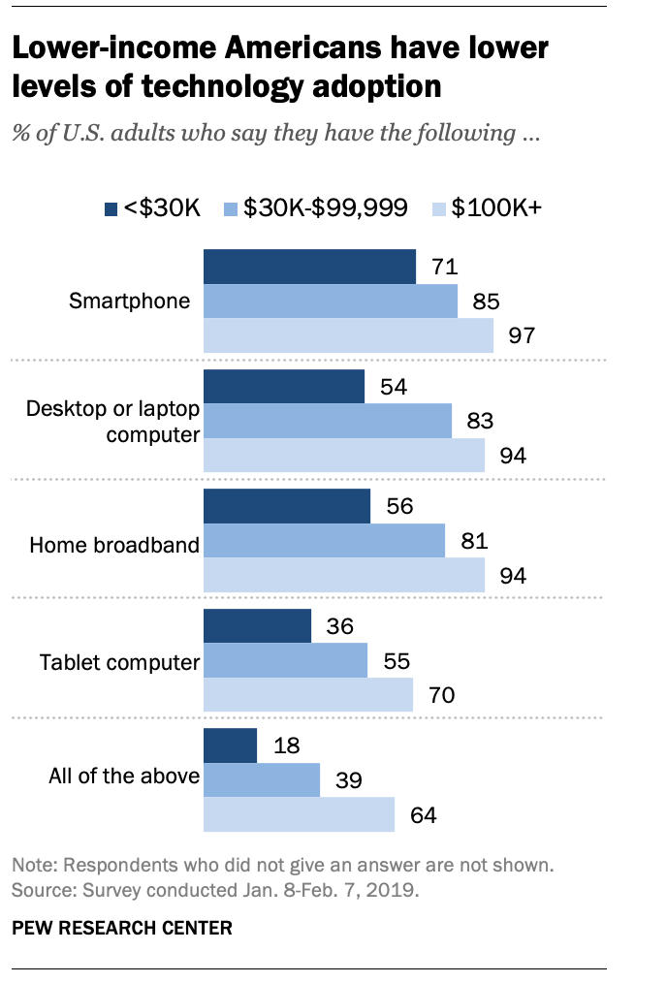
The smartphone blind-spot
Many of us in CSE assume that “everyone”
has smartphones
More generally, we assume “everyone” has access to the Internet

Slide 6
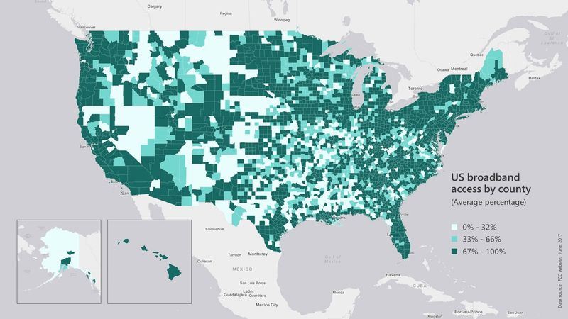
Broadband access
https://assets.bwbx.io/images/users/iqjWHBFdfxIU/iZSjibxE1KJs/v1/800x-1.jpg

Slide 7
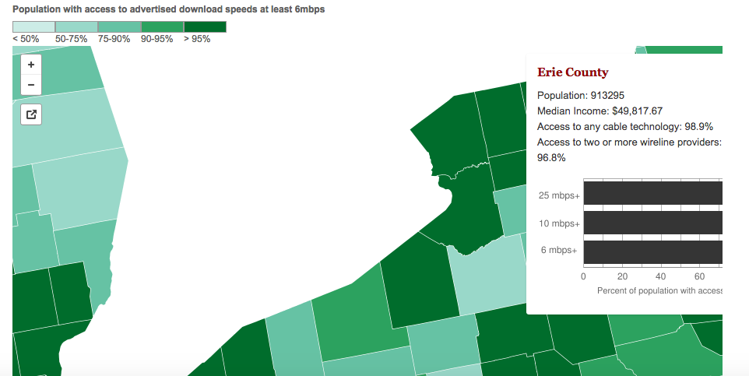
Erie county is reasonably good
http://www.governing.com/gov-data/broadband-speeds-availability.html

Slide 8
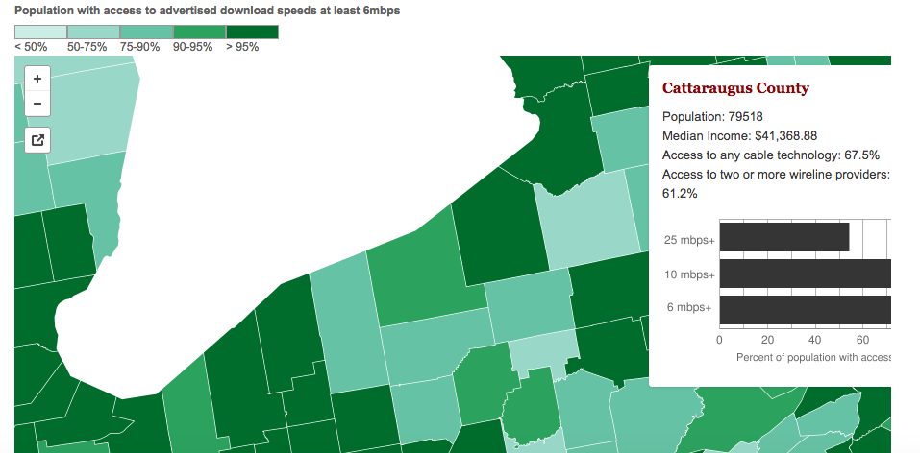
One county over
http://www.governing.com/gov-data/broadband-speeds-availability.html

Slide 9
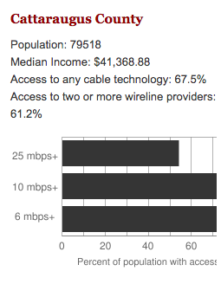
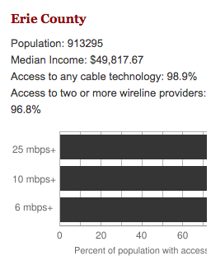
Make broadband more available
Say you are tasked to come up with the infrastructure

Slide 10
CSE 331 input from last two offerings
Input requirements
Decide whether this will be
for-profit enterprise
Where are the customers located?
What are technology should
we use?
What are the bandwidth requirements?
How is the input represented?
Get regulatory approval
What objective are we optimizing?
Get funding
How should the connections be configured?
Hire people
Output requirements
Get access to physical space
Problem Definition
Outreach
Where should we lay down the physical stuff?
What algorithm should be use to do this?
Algorithm Design
Implement the scheme
How should we do testing and maintenance?

Slide 11
Main Steps in Algorithm Design
Problem Statement
Real world problem
Problem Definition
Precise mathematical def
Algorithm
“Implementation”
Data Structures
Analysis
Correctness/Run time

Slide 12
Now you no longer are a student in CSE 331
Very quick overview
3 assignments that touch on the issue of high speed Internet

Slide 13
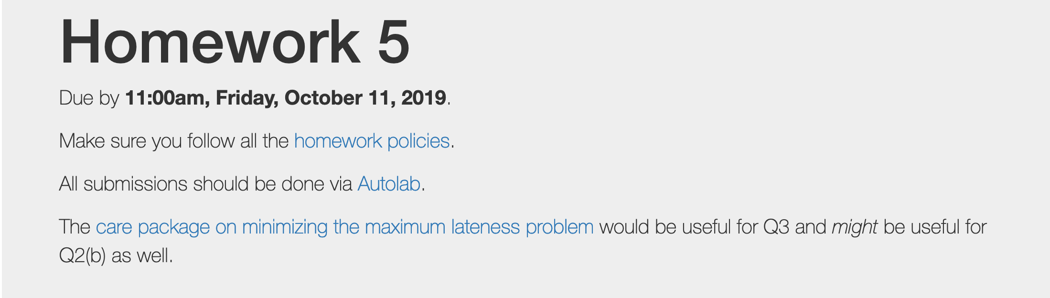
Fast forward ~1.5 months

Slide 14
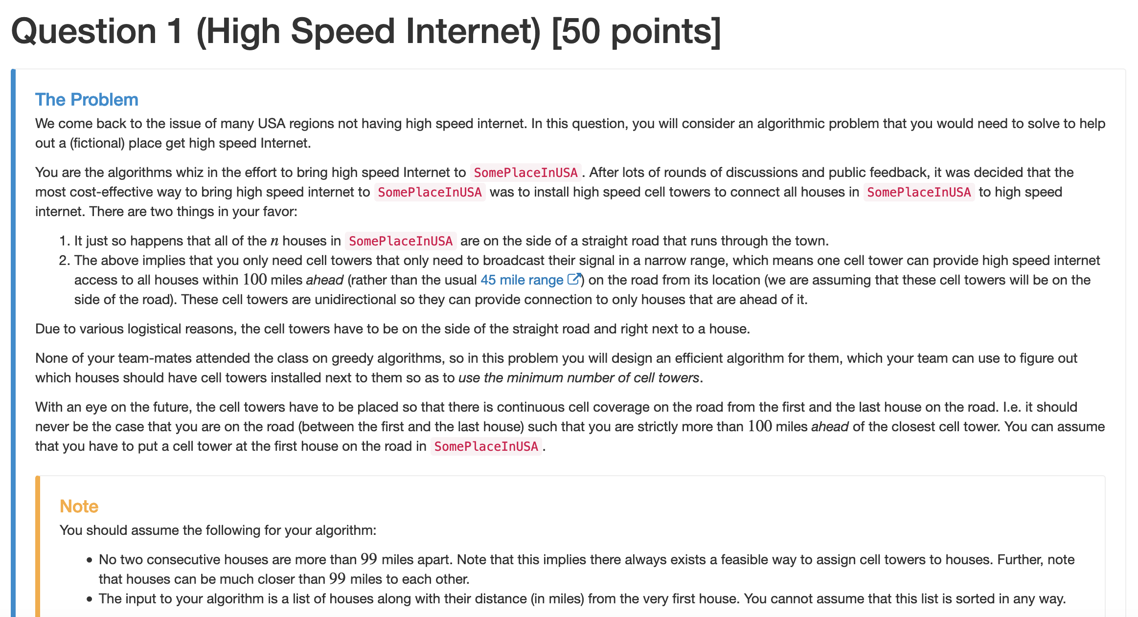
Question 1 on HW 5
Greedy Algorithm question

Slide 15

Fast forward to last couple of weeks of class

Slide 16
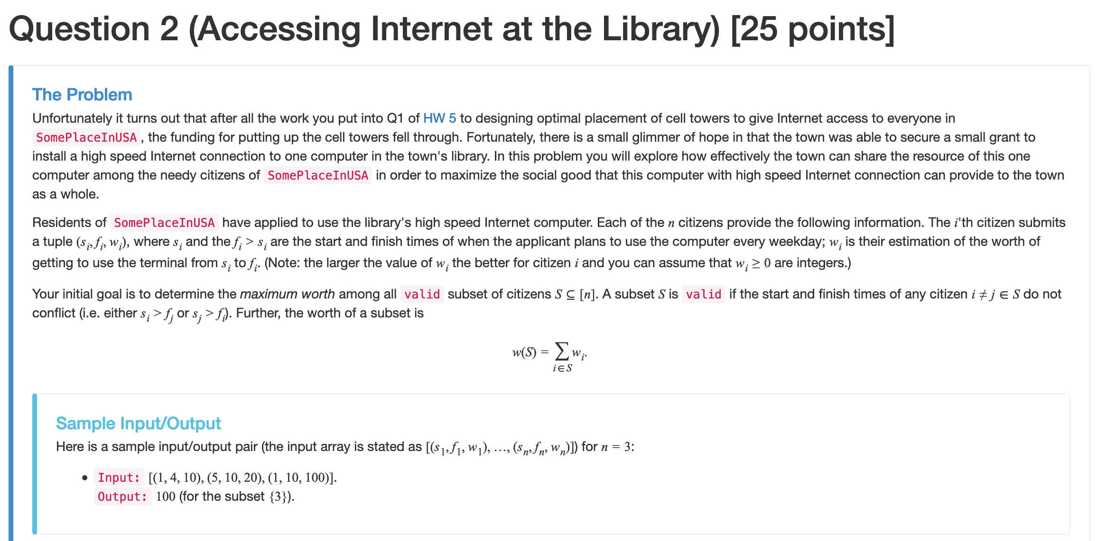
Question 2 on HW 9
Dynamic Program question

Slide 17
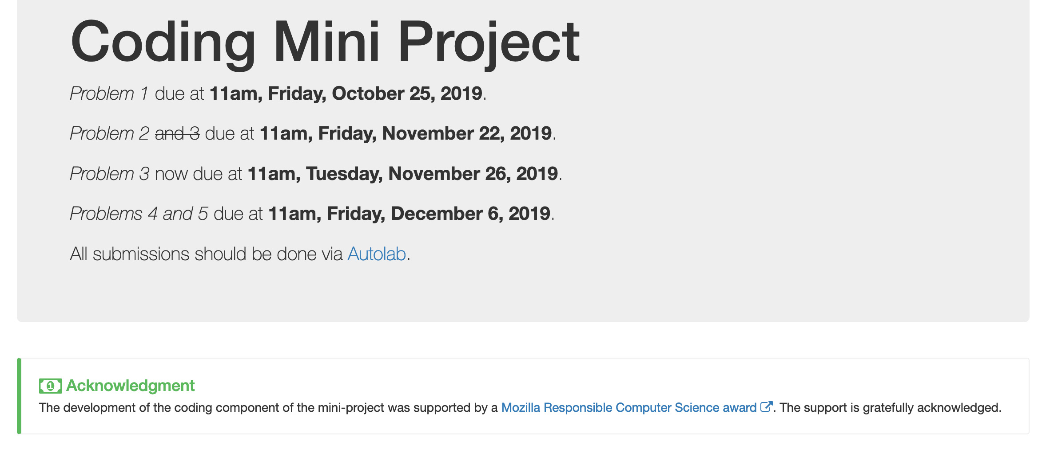
The most exciting part!

Slide 18
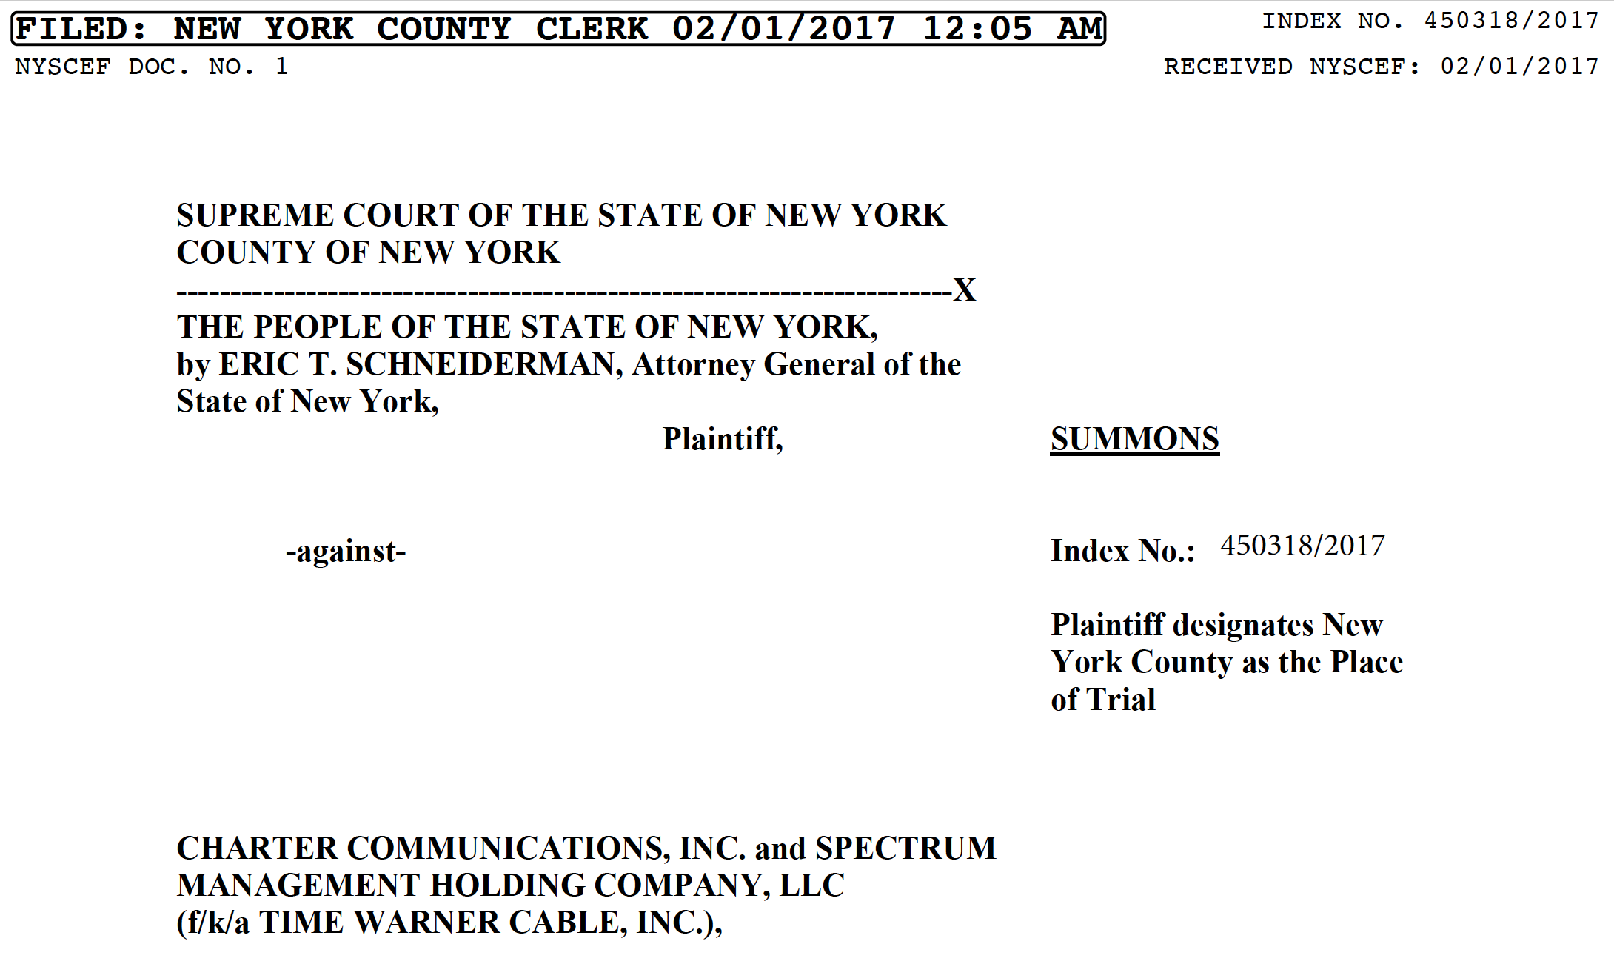

The context for the project

Slide 19
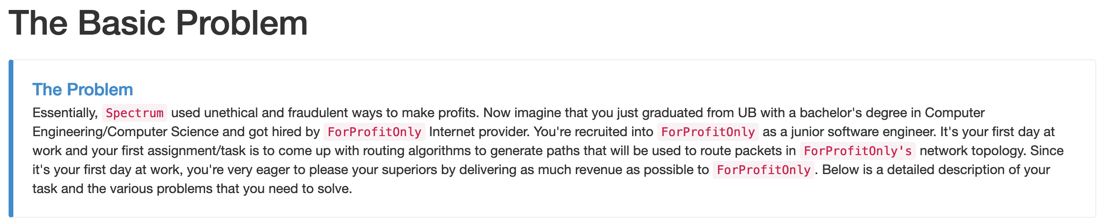
Very high level overview

Slide 20
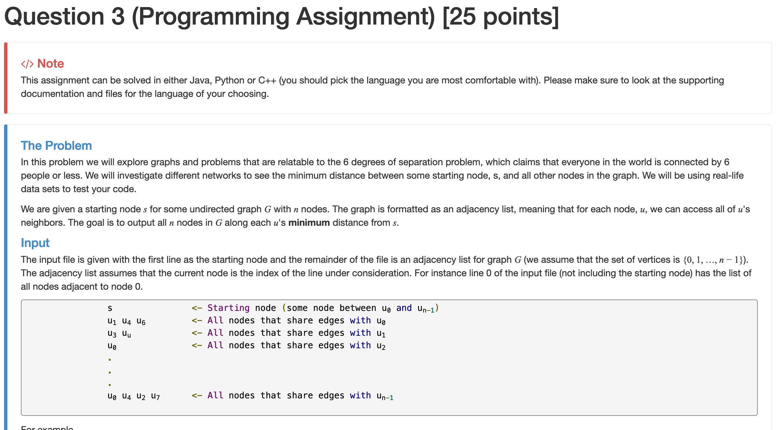
Problem 1 (Warmup)
Use Breadth First Search to pick routing paths

Slide 21
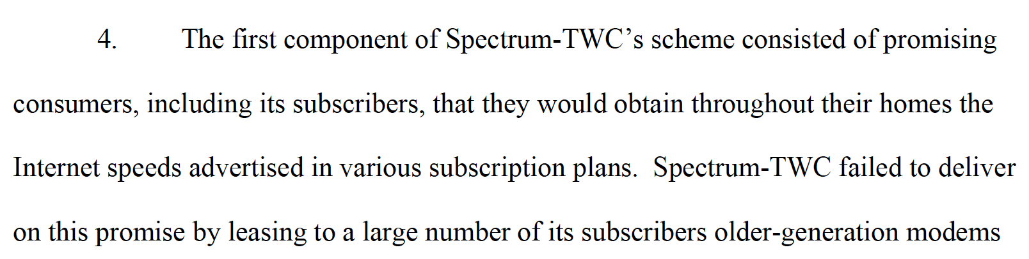
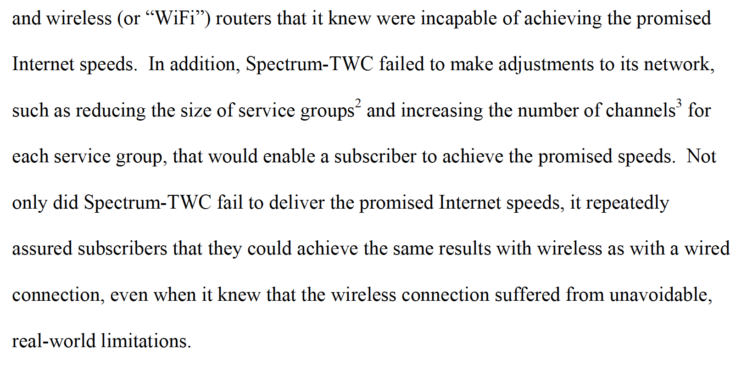
Allegation #4 against Spectrum
Problem 2

Slide 22
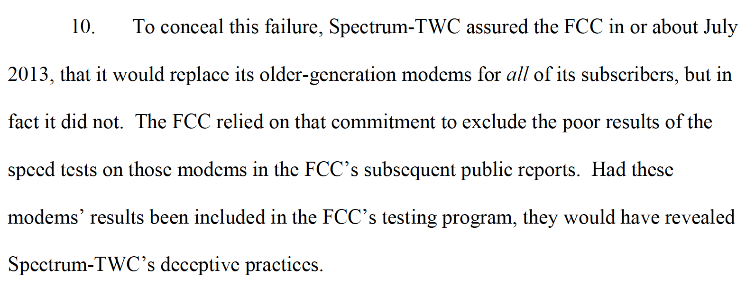
Allegation #10 against Spectrum
Problem 3

Slide 23
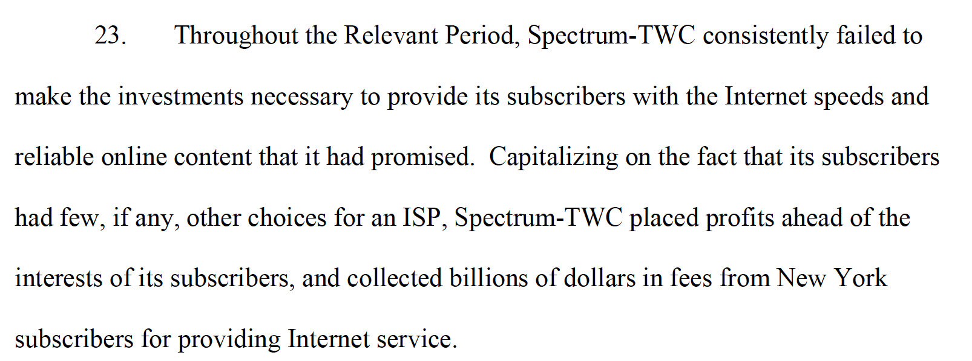
Allegation #23 against Spectrum
Problem 4

Slide 24
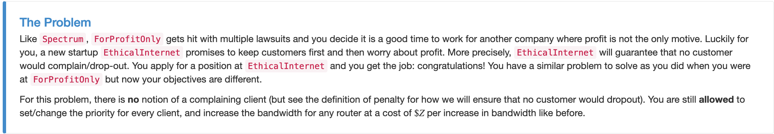
Problem 5: Do the ethical thing
Doing the ethical thing gave them full points on Problem 3 and 4 as well :-)

